Slide 1
PL 2
Introduction to Java

Slide 2
Java is a general- purpose, object-oriented programming language.
It is developed by James Gosling, Patrick Naughton, Chris Warth, Ed Frank and Mike Sheridan at Sun Microsystems of USA in 1991.
It was originally called “Oak” but was renamed “Java” in 1994.
It was designed for the development of software for consumer electronic devices like TV, VCR, Toasters, Cable set top boxes, PDA and other electronic machines

Slide 3
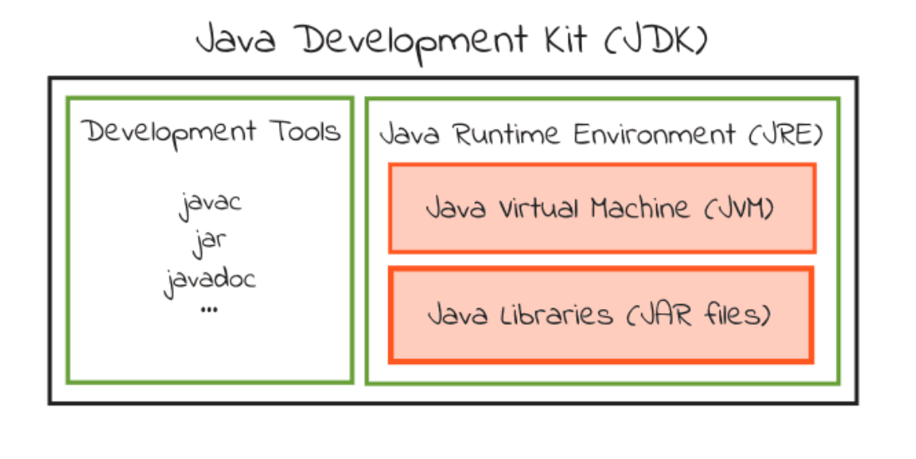
JDK,JRE,JVM

Slide 4
JDK: It contains a Java compiler, a full copy of the Java Runtime Environment (JRE), and many other important development tools.
JRE: JRE complementing the JVM with a just-in-time (JIT) compiler, converts intermediate bytecode into native machine code on the fly. The Java platform also includes an extensive set of libraries.
JVM:The heart of the Java platform is the "virtual machine" that executes Java bytecode programs. It is a very important part of both JDK and JRE because it is contained or inbuilt in both. Whatever Java program you run using JRE or JDK goes into JVM and JVM is responsible for executing the java program line by line, hence it is also known as an interpreter.
JRE (Java Runtime), which include a Java Virtual Machine and core libraries, is needed for running Java programs. JDK (Java Development Kit), which includes JRE plus the development tools (such as compiler and debugger), is need for writing as well as running Java programs. In other words, JRE is a subset of JDK. Since you are supposed to write Java Programs instead of merely running Java programs, you should install JDK, which includes JRE.
The Java compiler, which converts Java source code into Java bytecode (an intermediate language for the JVM), is provided as part of the Java Development Kit (JDK). The Java Runtime Environment (JRE), complementing the JVM with a just-in-time (JIT) compiler, converts intermediate bytecode into native machine code on the fly. The Java platform also includes an extensive set of libraries.

Slide 5
The Java Development Kit comes with a collection of tools that are used for developing and running Java programs.
Tool | Description
javac (Java compiler) | It is java compiler and used to compile java program. It translates java source code to byte code files that the interpreter can understand.
java (Java interpreter) | It is java interpreter and used to run an applet and application program by reading and interpreting byte code files.
appletviewer (view java applet) | It enables us to run java applets (without actually using a java compatible browser).
javah (C header files) | It generates C header files and source files that are needed to implement native methods.
javap (Java disassembler) | It is java disassembler and used to convert byte code files into a program description.
jdb (java debugger) | It is used to find errors in our programs
javadoc (java document for creating HTML documents) | It is used to create HTML-format documentation from java source code files.

Slide 6
Simple Java Program
public class myclass
{
public static void main(String[] args)
{
System.out.println("Helloworld");
}
}
Save file as myclass.java
Open Command Prompt.
Type following path to Command prompt C:\Program Files\Java\jdk1.8.0_131\bin>
Compile above java code javac myclass.java
Interpret above file by using java myclass

Slide 7
Features of java
1. Compiled and Interpreted language
2. Platform-Independent and Portable
3. Object Oriented
4. Robust and Secure
5. is Distributed
6. Familiar, Simple and Small
7. Multithreaded and Interactive
8. High Performance
9. Dynamic
10. Architecture Neutral
11. popular for Internet

Slide 8
class Rectangle
{
int length, width;
Rectangle (int x, int y) //defining constructor
{
length = x; width = y;
}
int rectarea()
{
return(length * width); }
}
class Rectanglearea //class with main method
{
public static void main (String args[ ])
{
Rectangle rect1 = new Rectangle(15,10); //calling constructor
int area1=rect1.rectarea();
System.out.println(“Area1= “ + area1);
}
}

Slide 9
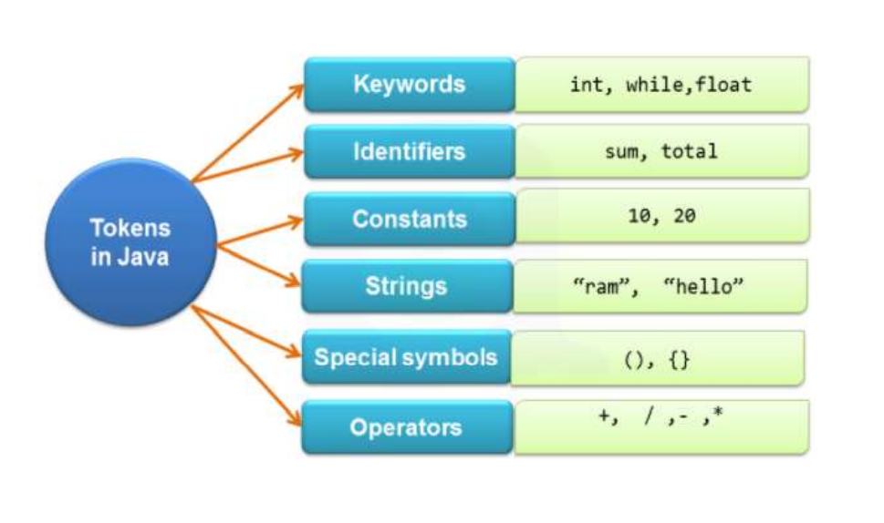
Tokens in Java

Slide 10
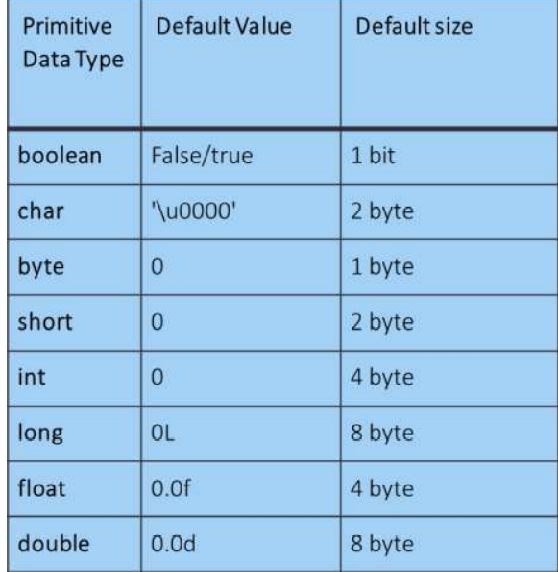
Data Types Data types specify the different sizes and values that can be stored in the variable.

Slide 11
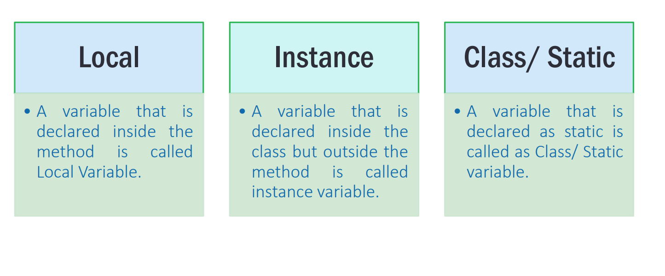
Types of variables

Slide 12
Array:
An array is a collection of similar types of data. For example, if we want to store the names of 100 people then we can create an array of the string type that can store 100 names.
Obtaining an array is a two-step process.
First, you must declare a variable of the desired array type .
Second, you must allocate the memory that will hold the array, using new, and assign it to the array variable
datatype [] arrayname;
Arrayname = new type[size];
For example:
int []numbers;
numbers = new int [10];
In Java, we can initialize arrays during declaration.
Foe example: int [] age= {12,34,25,56,78}

Slide 13
For Each Loop
The for-each loop is used to traverse array or collection in java.
It is easier to use than simple for loop because we don't need to increment value.
Example:
public class ForEachExample {
public static void main(String[] args) {
int arr[]={1,2,3,7,8,14,15}; //Declaring an array
//Printing array using for-each loop
for(int i:arr){
System.out.println(i);
}}}
Syntax:
for(Type var:array)
{
//code to be executed
}

Slide 14
Command line arguments
class testarg {
public static void main(String args[]) {
for(int i=0;i<args.length;i++)
{
System.out.println("Args[" + i + "] is " + args[i] );
}
}
Steps to run program
javac testarg.
java testarg C C++ Java
Output
Args[0] is C
Args[1] is C++
Args[2] is Java

Slide 15
class Hello {
public static void main(String[] args)
{
// check if length of args array is greater than 0
if (args.length > 0) {
System.out.println("The command line" + " arguments are:");
// iterating the args array and printing the command line arguments
for (String val : args)
System.out.println(val);
}
else
System.out.println("No command line "+ "arguments found.");
}
}

Slide 16
public class paradd
{
public static void main(String a[])
{
int i,j,sum=0;
i= Integer.parseInt(a[0]);
j=Integer.parseInt(a[1]);
sum=i+j;
System.out.println("Sum of i and j is:" + sum);
}
}

Slide 17
class Room
{
int length,breadth,height;
Room(int l,int b,int h) //parameterized constructor
{
length=l; breadth=b; height=h;
}
Room(int len) //constructor overloading
{
length=breadth=height=len;
}
int volume()
{
return length*breadth*height;
}
class OverloadConstructor
{
public static void main(String args[]) {
Room a=new Room(20,30,40);
Room b=new Room(10);
int vol;
vol=a.volume();
System.out.println("Volume of room a is " + vol);
vol=b.volume();
System.out.println("Volume of room b is " + vol);
}
}

Slide 18
class Complex {
private double re, im;
//parameterized constructor
Complex(double re, double im) {
this.re = re;
this.im = im;
}
// copy constructor
Complex(Complex c) {
System.out.println("Copy constructor called");
re = c.re;
im = c.im;
}
void display()
{
System.out.println("Complex Number");
System.out.println(re +" + "+im+"i");
}
}
public class Main {
public static void main(String[] args) {
Complex c1 = new Complex(10, 15);
c1.display();
Complex c2 = new Complex(c1);
c2.display();
}
}

